Slide 1
Loan payments

Slide 2
1.What I am planning to do?
Machine learning Algorithms are being applied to assess the loan repayments of customers using 3 main loan statuses which are 'PAIDOFF', 'COLLECTION', 'COLLECTION_PAIDOFF‘ , other attributes I am considering here is Age, Education, Gender of the customers and time taken to paid their loan back
In this problem, the goal is to model the multiple algorithms and assess their scores, comparing the models and choosing the best algorithm for our Dataset.

Slide 3
2.What data attributes I have here?
Loan_id : A unique loan number assigned to each loan customers
Loan_status: Whether a loan is paid off, in collection, new customer yet to payoff, or paid off after the collection efforts
Principal: Basic principal loan amount at the origination terms, could be weekly (7 days), biweekly, and monthly payoff schedule
Effective_date: When the loan got originated and took effects
Due_date: Since it’s one-time payoff schedule, each loan has one single due date
Paidoff_time: The actual time a customer pays off the loan
Pastdue_days: How many days a loan has been past due
Age, Education, Gender: A customer’s basic demographic information

Slide 4
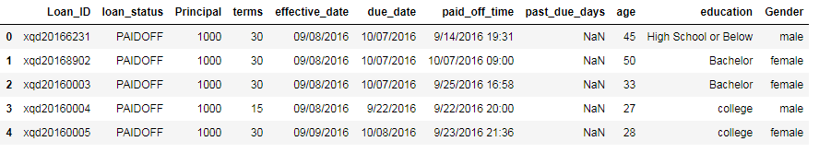
3. Sample data?
Notes:
First five rows of dataset

Slide 5
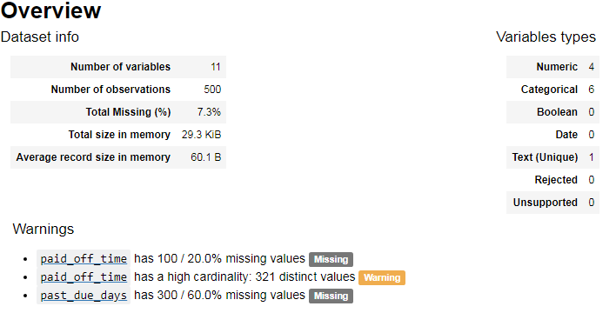
4. Data specifics I have identified?

Slide 6
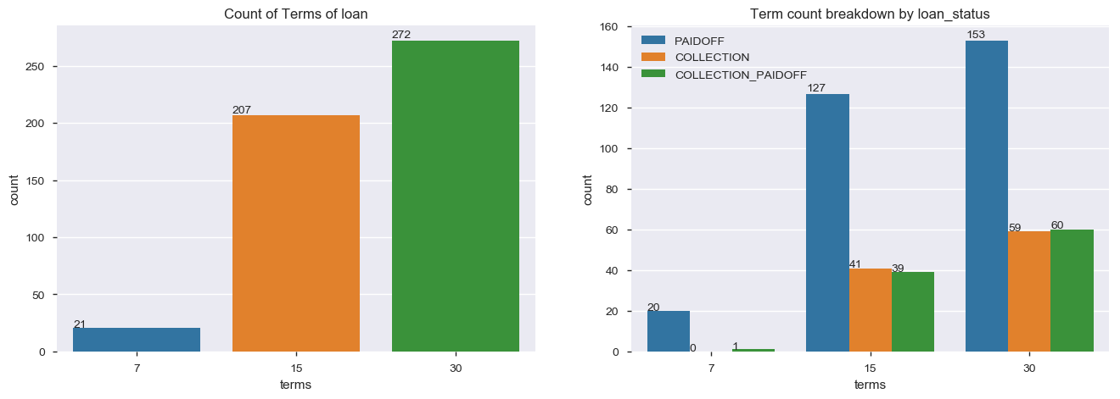
5. Data Visualizations
Notes:
Loan status and Count of loan terms status

Slide 7
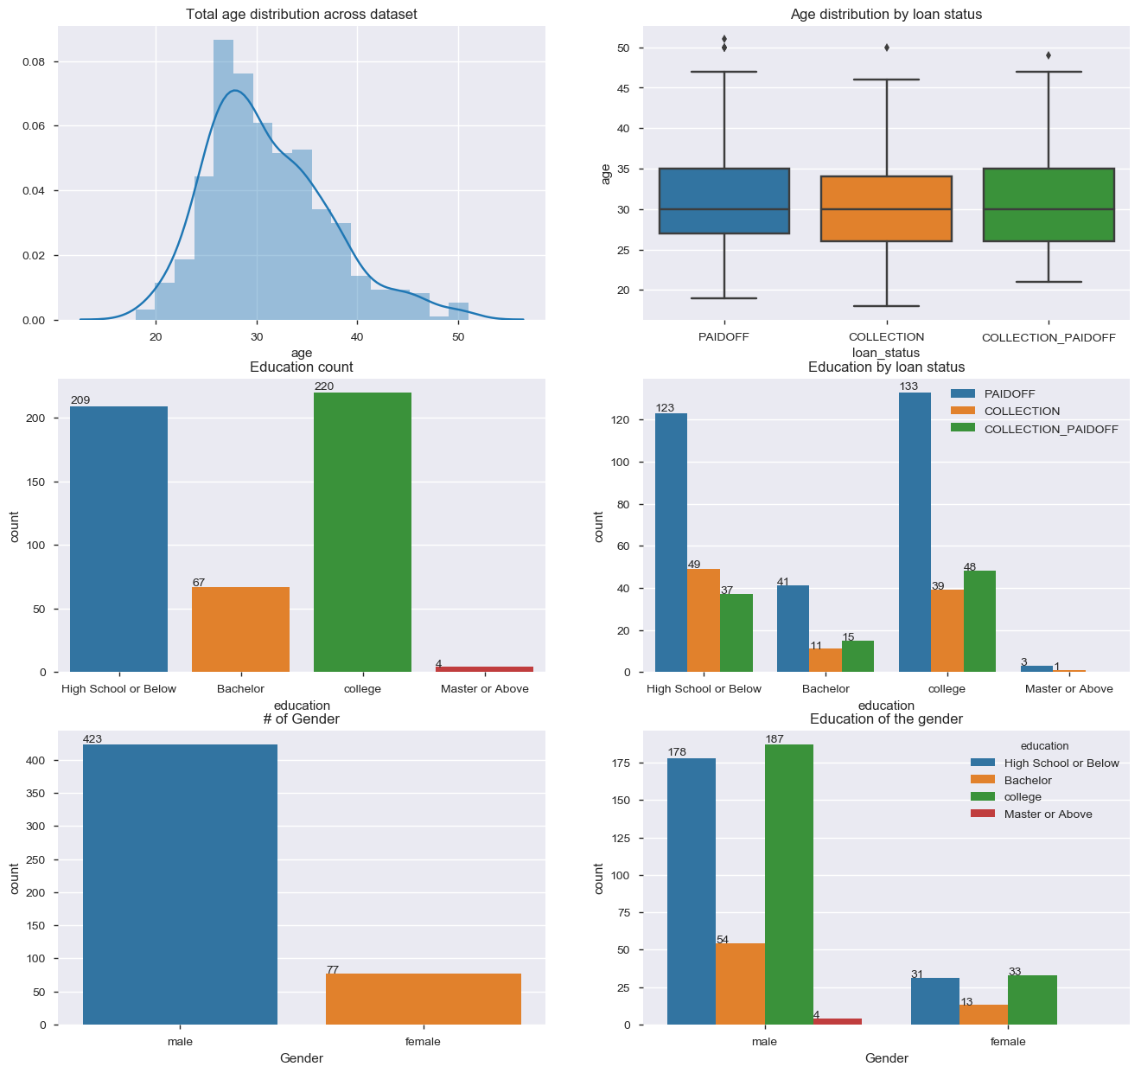
Notes:
We have here all graphs in the order as follows Age Distribution and status, Education and Loan status, Educations of Gender

Slide 8
6. Explanation on Model evaluation
We are ready to Predict a Model and Solve the required solution. I am identifying relationship between output Loan status with (Gender, Age, Education) using the following algorithms :
1. Linear Regression
2. Logistic Regression
3. k-Nearest Neighbours (KNN)
4. Support Vector Machines(SVM)
5. Naive Bayes classifier
6. Decision Tree
7. Random Forrest
8. Stochastic Gradient Descent
Notes:
Correlation matrix and explain why we are using only 4 attributes

Slide 9
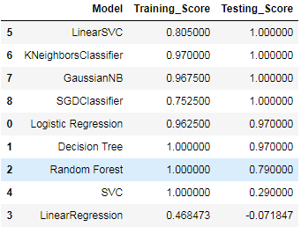
7. Explanation of the Model accuracy
Conclusions: We can now rank our evaluation of all the models to choose the best one for our problem. SVC, Decision Tree and Random Forest score the same, we choose to use Random Forest as they correct for decision trees.

Slide 10
Thank You

